Slide 1

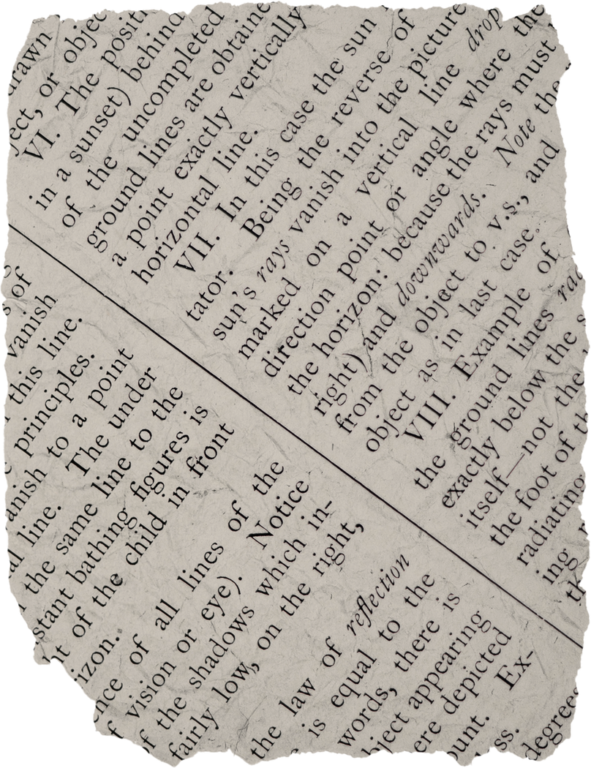
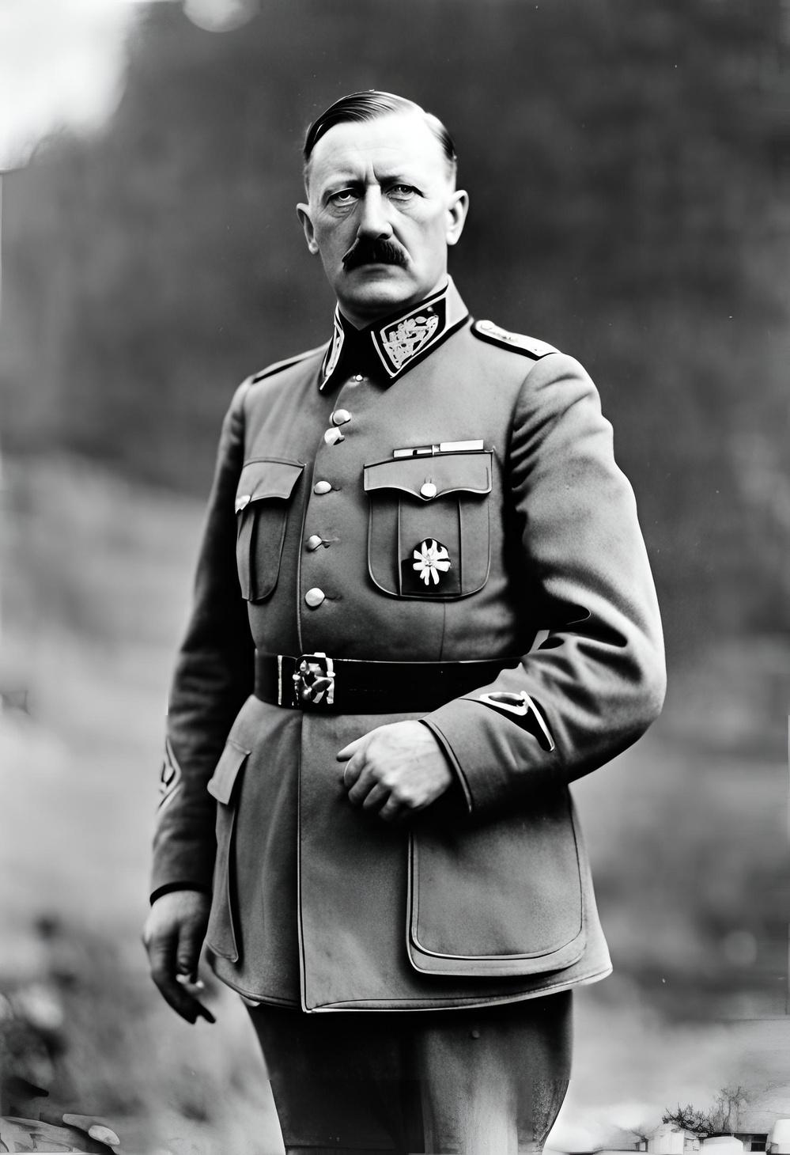
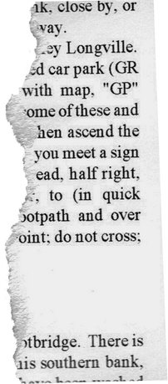



Adolf
Hitler
Rise and Fall of a Dictator

Slide 2
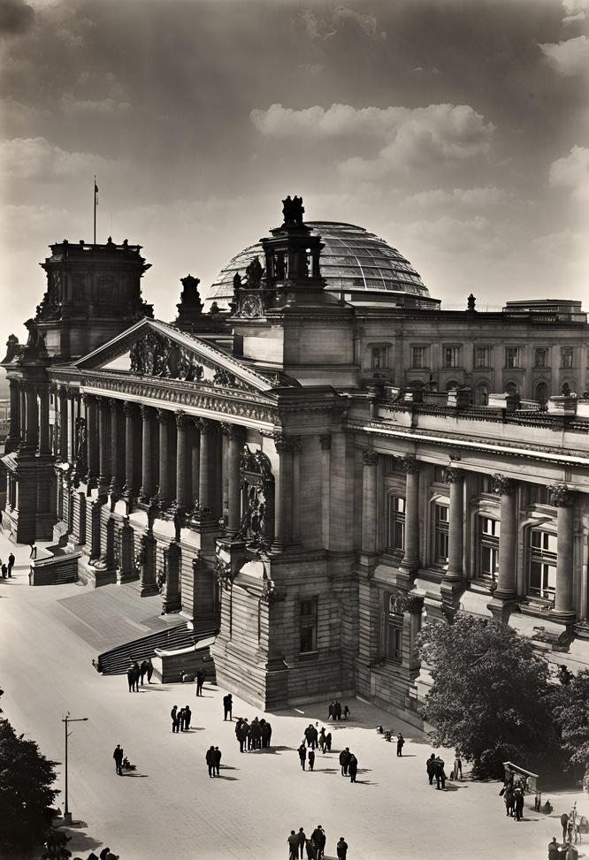
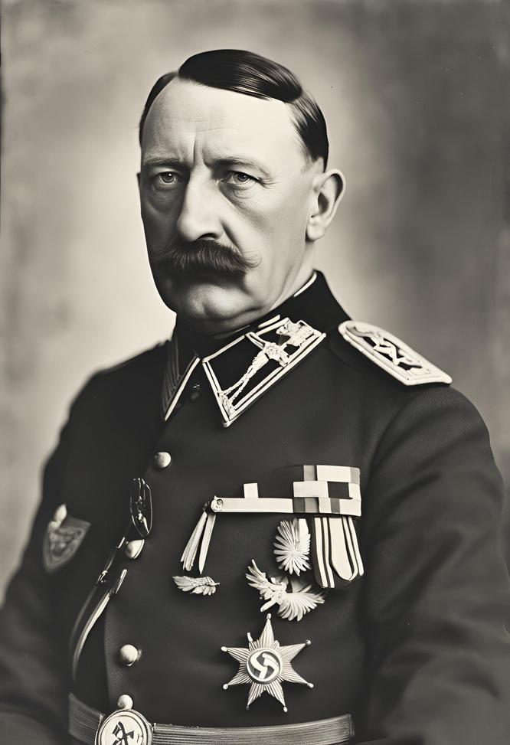
Understanding
the Context
Adolf Hitler, the leader of the Nazi Party, rose to power in Germany during a tumultuous period in history. Understanding the political, economic, and social context of the time is essential to comprehend the factors that contributed to his rise to power and the catastrophic consequences of his reign.

Slide 3
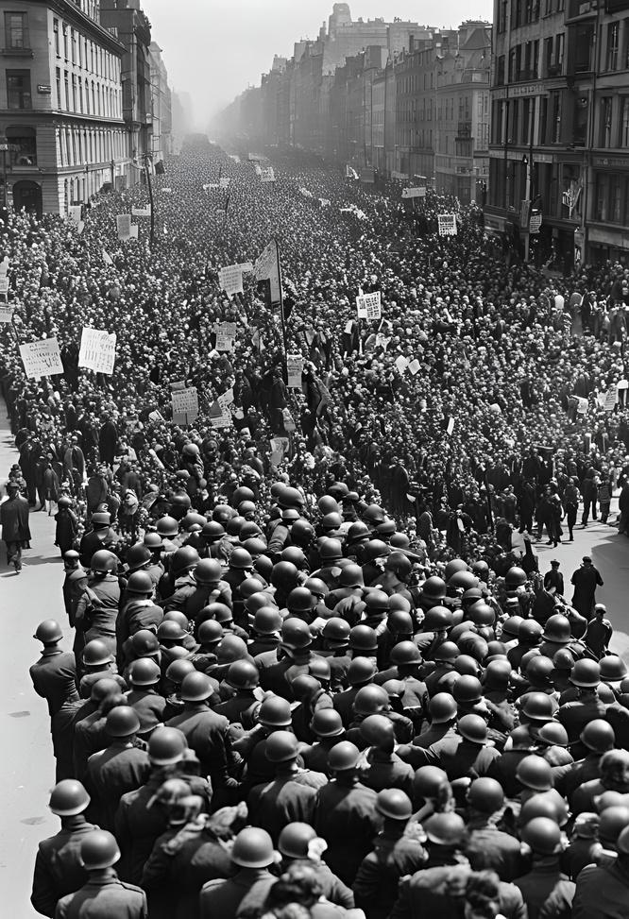
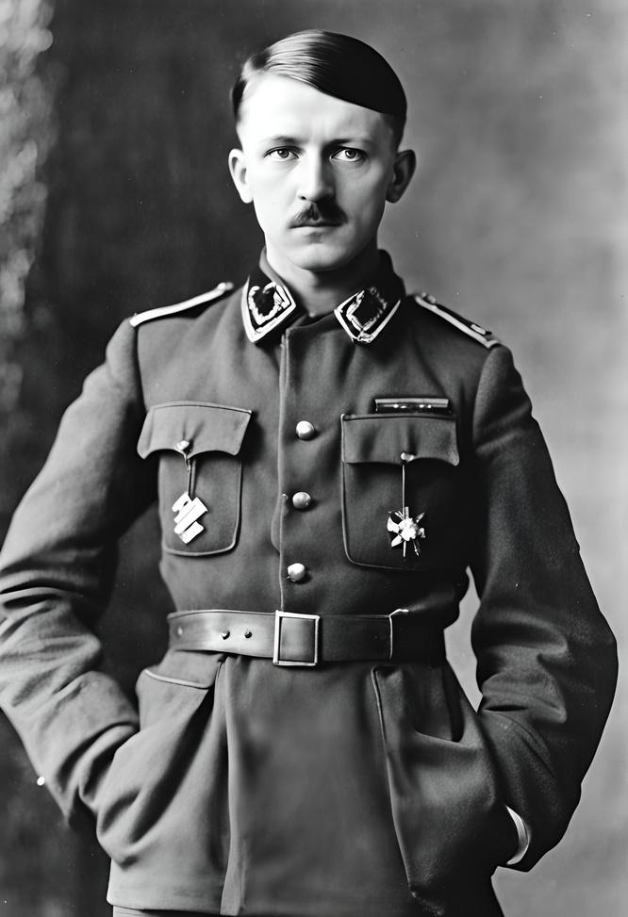
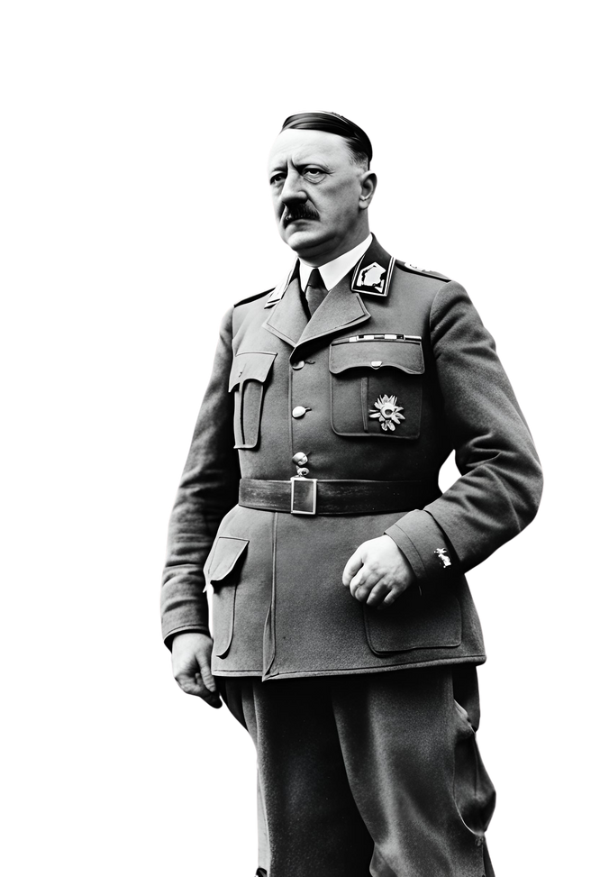
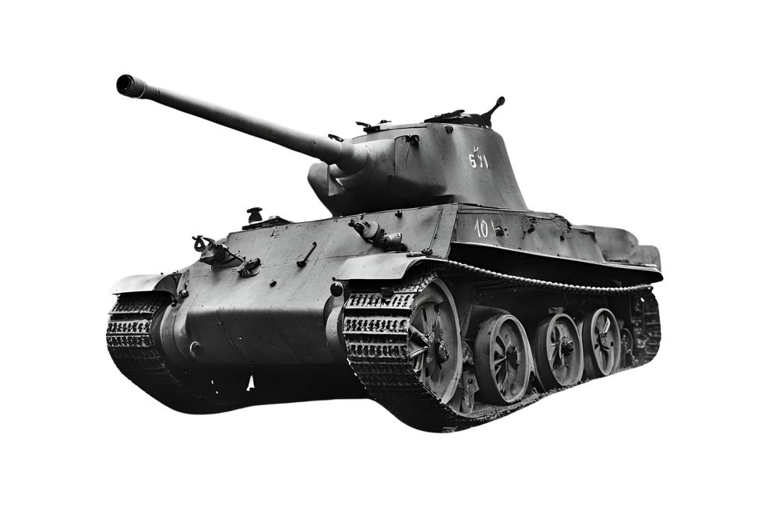

Early Life
The Making of a Dictator
Adolf Hitler, the leader of the Nazi Party, rose to power in Germany during a tumultuous period in history. Understanding the political, economic, and social context of the time is essential to comprehend the factors that contributed to his rise to power and the catastrophic consequences of his reign.

Slide 4
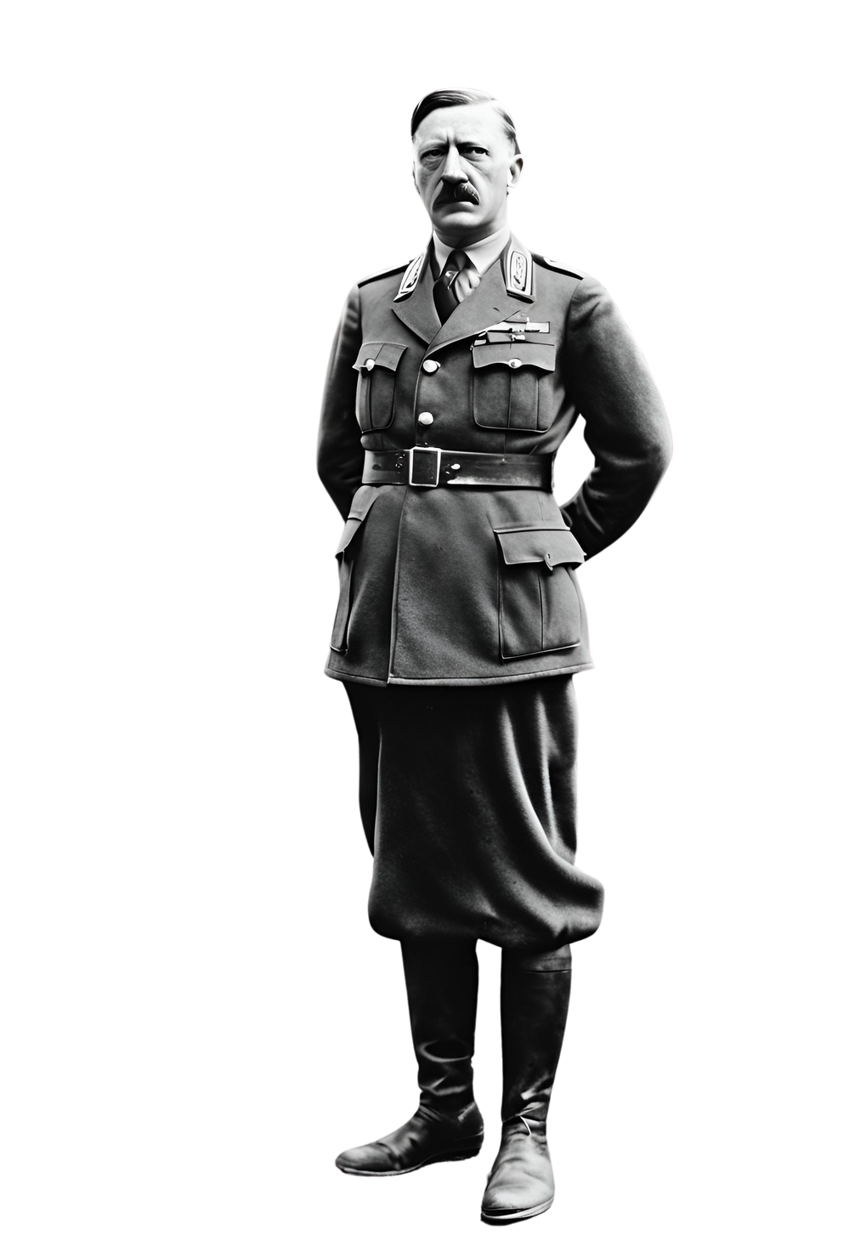
From Chancellor
to Dictator
In 1933, Hitler was appointed Chancellor of Germany by President Paul von Hindenburg. Using legal and political maneuvers, as well as intimidation and violence, Hitler swiftly consolidated his power and eliminated political opposition.
The Reichstag Fire Decree and the Enabling Act granted Hitler dictatorial authority, effectively marking the end of democracy in Germany and the beginning of Nazi tyranny.

Slide 5
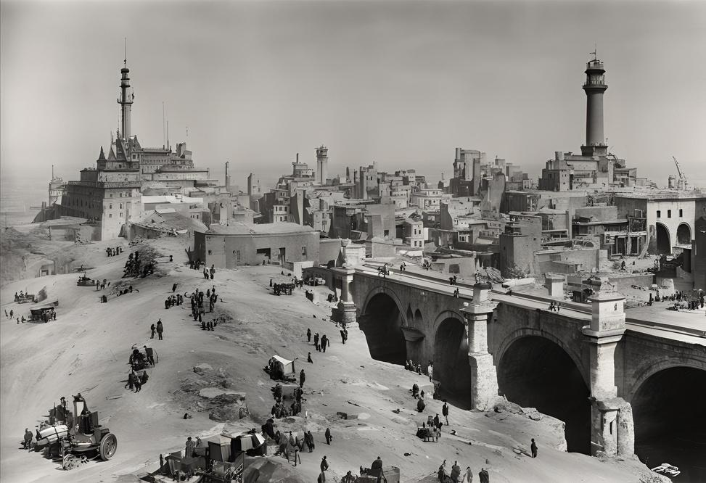
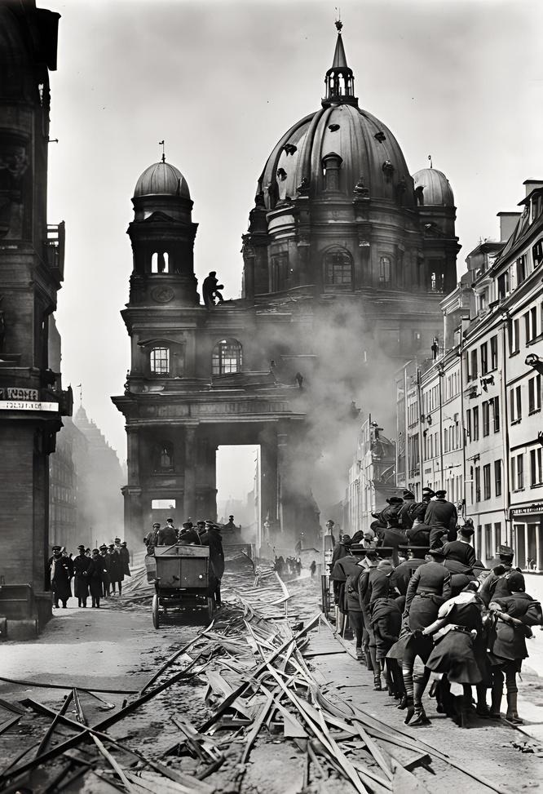
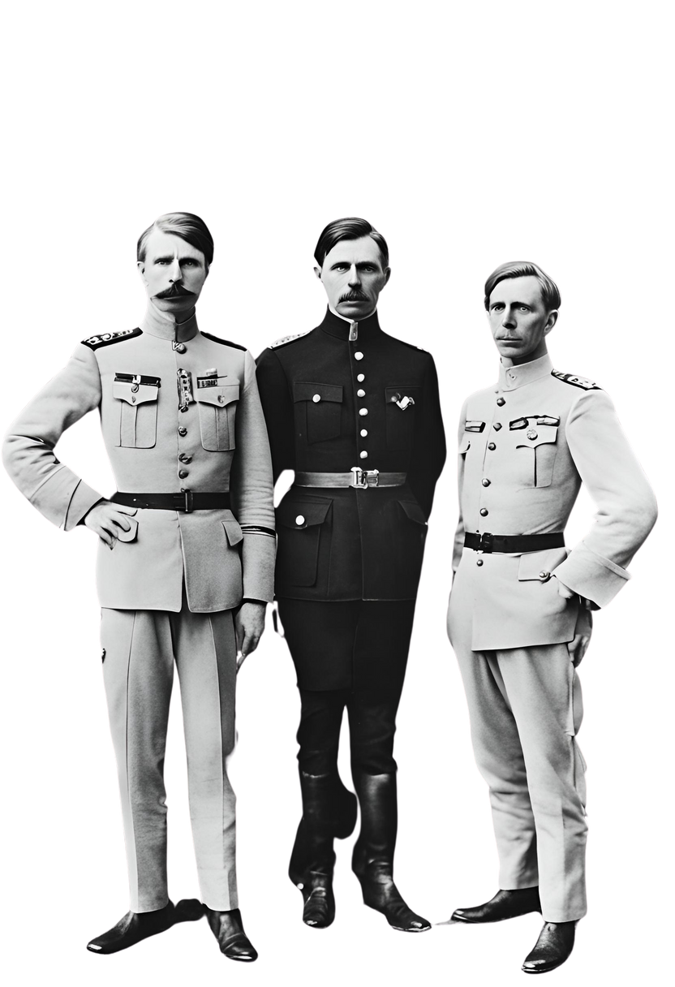
World War I
The Great War and Its Aftermath
During World War I, Hitler served as a soldier in the German army, where he was decorated for bravery and wounded in combat. The war's end in 1918 left Germany in a state of political and economic turmoil, with widespread discontent and social unrest. Hitler's experiences during the war and its aftermath would later fuel his political ambitions and extremist ideologies.

Slide 6
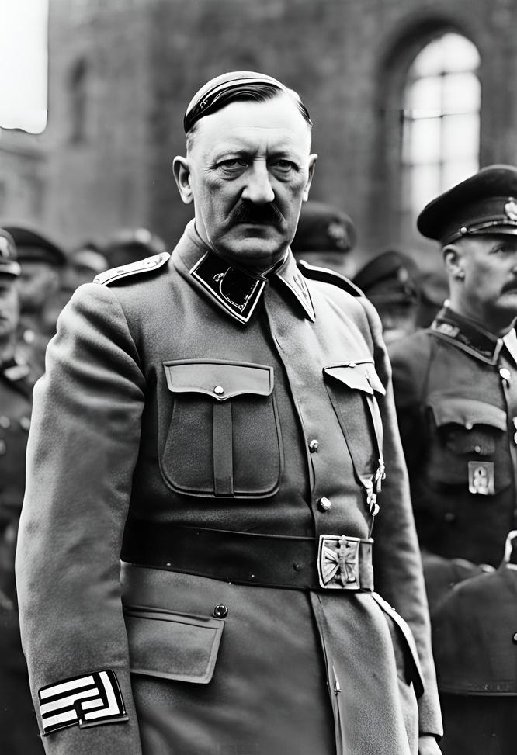
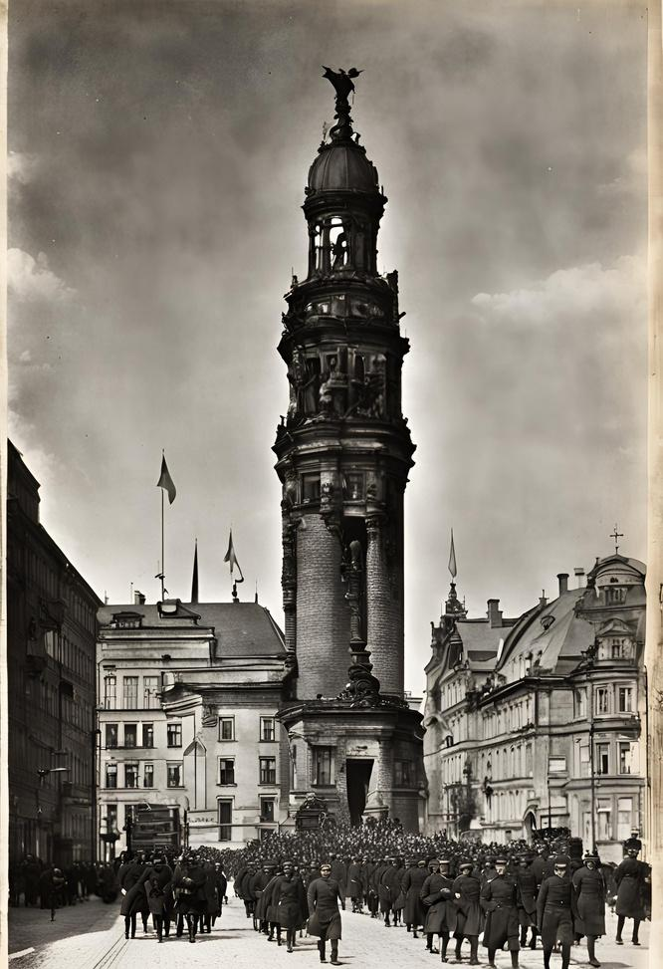
Seeds of Hatred
and Nationalism
In the aftermath of World War I, Germany experienced a period of instability and economic hardship. Amidst this turmoil, Hitler found a fertile ground for his nationalist and anti-Semitic beliefs. In 1919, he joined the German Workers' Party, which would later evolve into the National Socialist German Workers' Party, or Nazi Party. Hitler's charismatic leadership, fiery rhetoric, and extremist ideology propelled him to prominence within the party, laying the foundation for his ascent to power.

Slide 7
The Rise of the Nazi Party
Post-War Turmoil:
Germany faced instability and economic hardship after World War I, creating a breeding ground for discontent and radical ideologies.
Hitler's Ideology:
Adolf Hitler capitalized on this unrest, promoting nationalist and
anti-Semitic beliefs that resonated with disillusioned citizens.
Party Formation:
In 1919, Hitler joined the German Workers' Party, which later transformed into the National Socialist German Workers' Party, or Nazi Party.
Hitler's Leadership:
Through impassioned speeches, and extreme ideology, he quickly rose to prominence within the party, laying the groundwork for his rise to power.

Slide 8
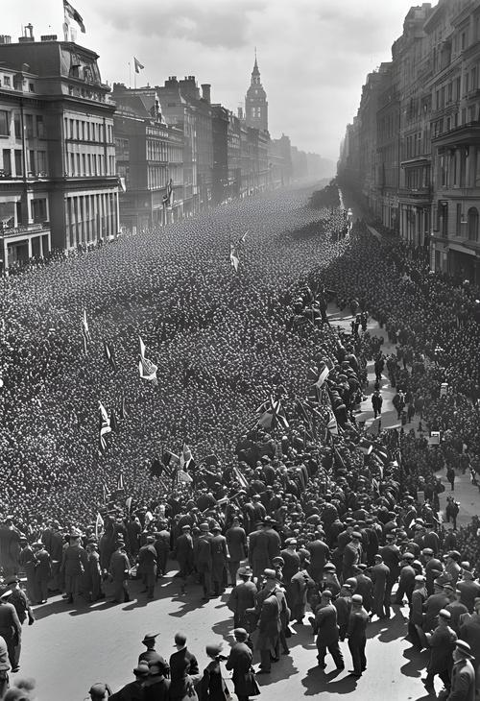
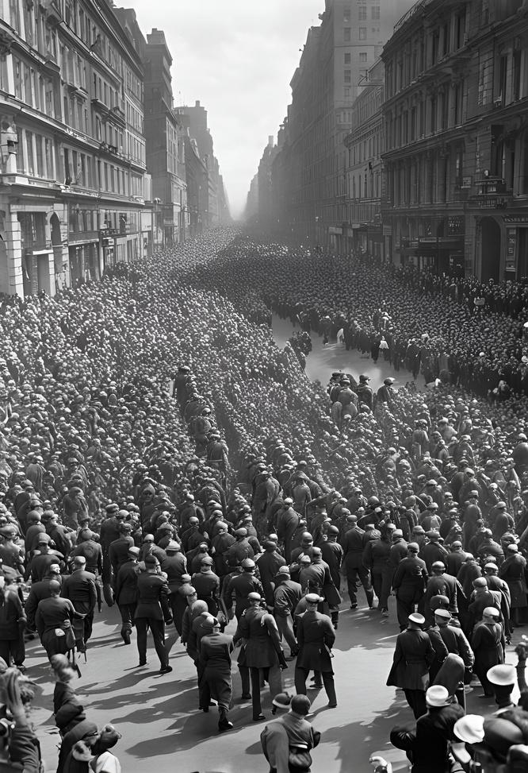
Manipulating Minds, Cultivating Support
Manipulating Minds, Cultivating Support
Hitler and the Nazi Party employed sophisticated propaganda techniques to manipulate public opinion and garner support for their extremist agenda. Through rallies, speeches, posters, and media, they spread nationalist, anti-Semitic, and militaristic messages, appealing to emotions and prejudices. This propaganda machine played a crucial role in shaping public perception and consolidating Hitler's power.

Slide 9
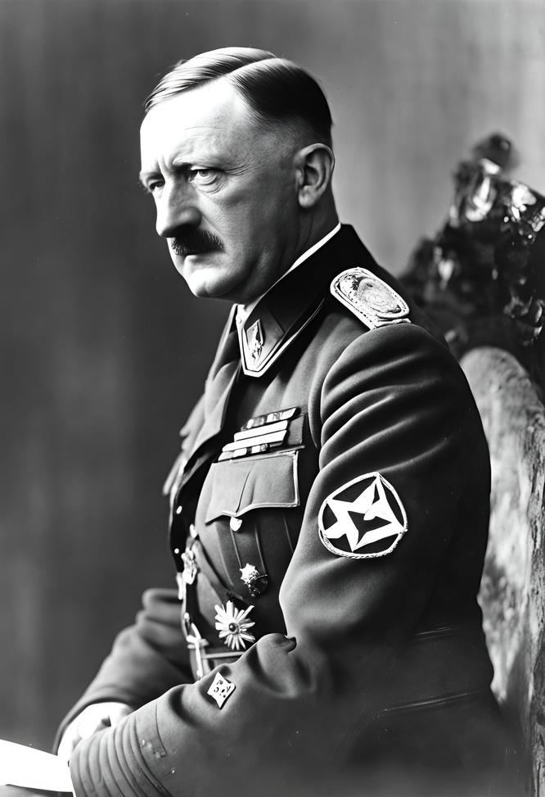
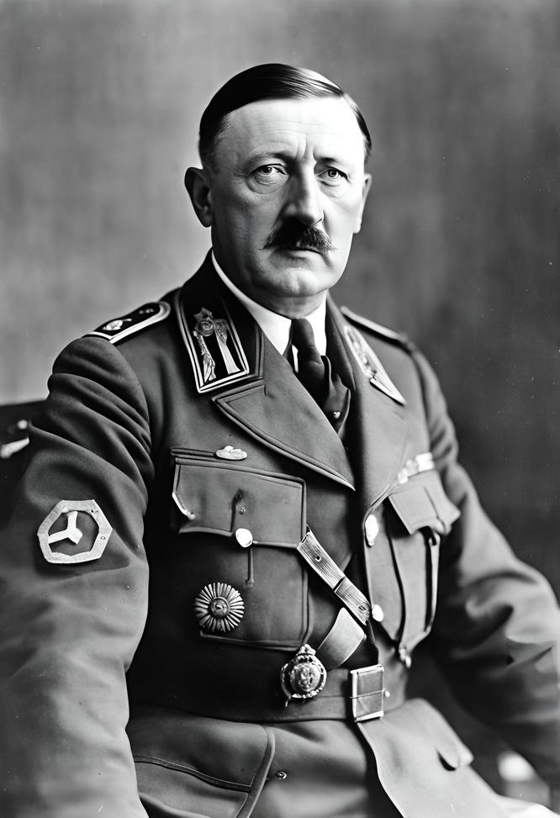
Appointment as Chancellor
Consolidation of Power
In 1933, Adolf Hitler was appointed Chancellor of Germany by President Paul von Hindenburg, leveraging his growing influence within the Nazi Party.
Through legal and political maneuvers, intimidation, and violence, Hitler swiftly eliminated political opposition and consolidated his power, centralizing authority under the Nazi regime.
Reichstag Fire Decree and Enabling Act
Hitler exploited the Reichstag fire in February 1933 to push through the Reichstag Fire Decree, suspending civil liberties and enabling the suppression of political opponents. Subsequently, the Enabling Act granted Hitler dictatorial authority, effectively ending democracy in Germany and paving the way for Nazi tyranny.

Slide 10
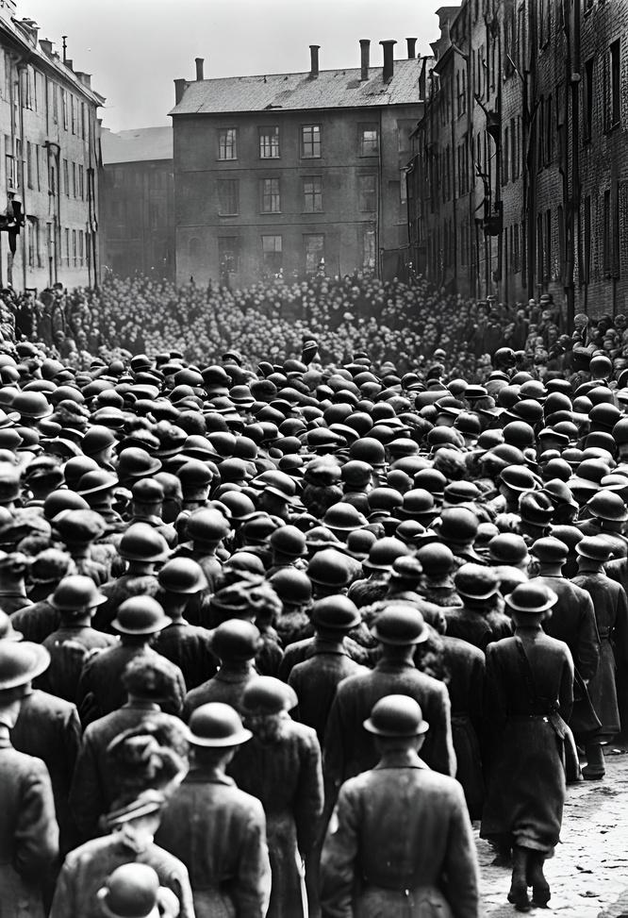
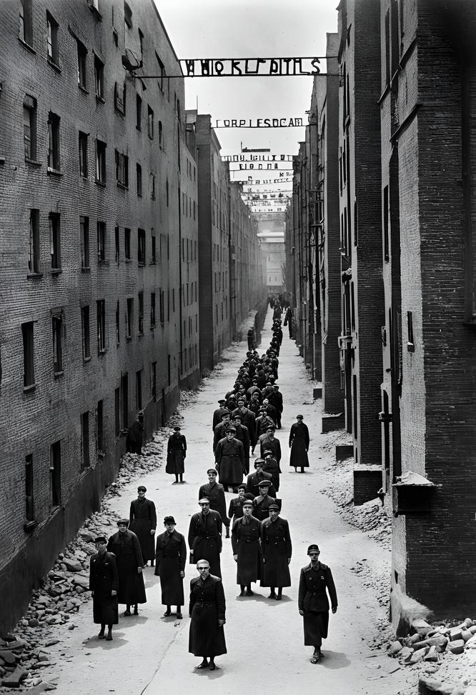
The Holocaust
Humanity's Darkest Chapter
Hitler's anti-Semitic beliefs and policies culminated in the Holocaust, the systematic genocide of six million Jews, as well as millions of other victims, including Roma, disabled individuals, political dissidents, and others deemed "undesirable" by the Nazi regime. The atrocities committed during the Holocaust serve as a chilling reminder of the consequences of hatred, bigotry, and unchecked power.

Slide 11
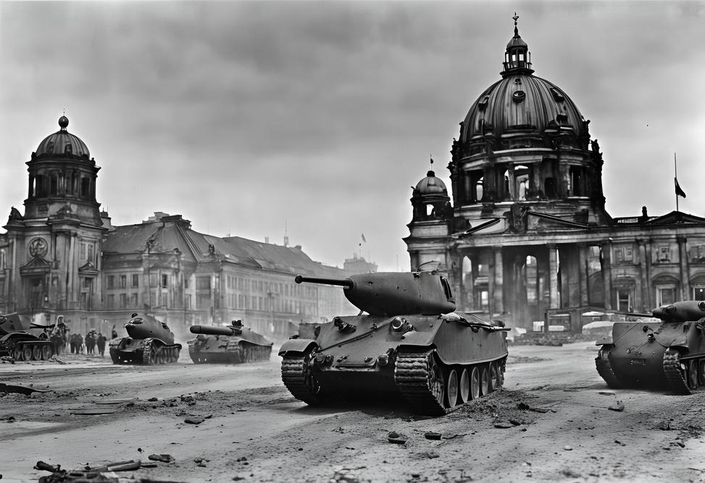
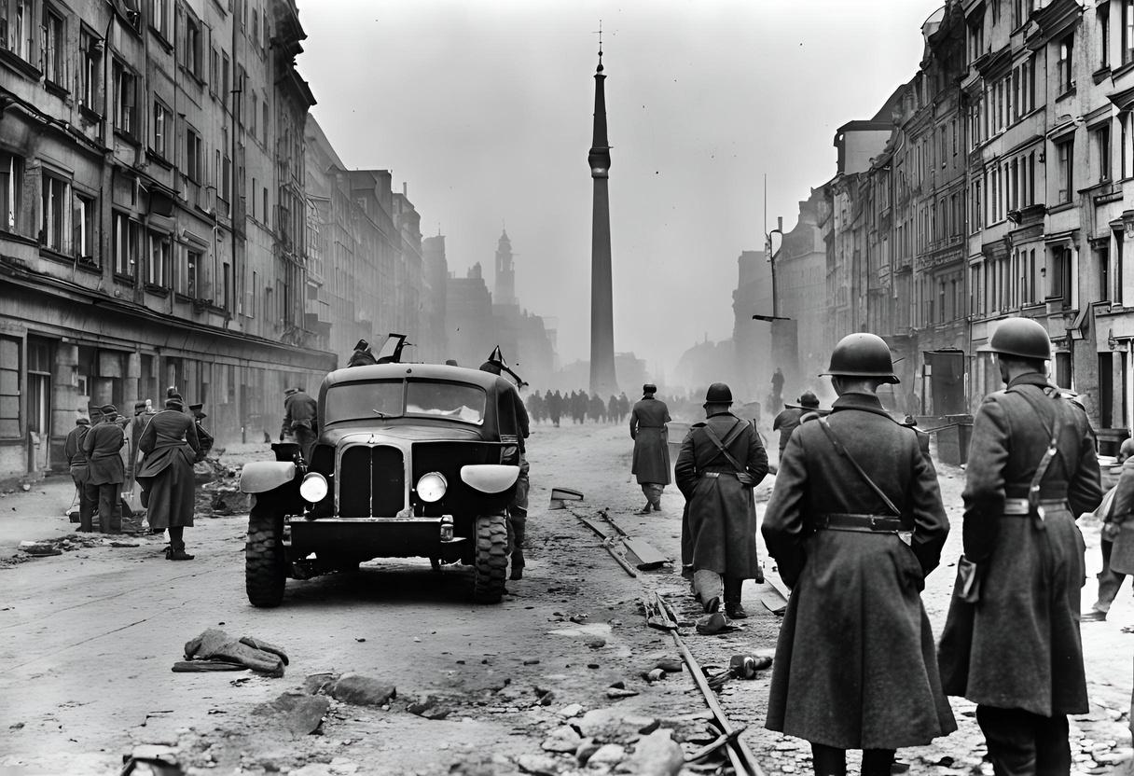
World War II
Hitler's expansionist ambitions and aggressive foreign policies precipitated the outbreak of World War II in 1939. The conflict engulfed much of the world, resulting in unprecedented devastation, loss of life, and suffering.
Hitler's military strategies and atrocities, including the invasion of Poland, the Blitzkrieg, and the Holocaust, left an indelible mark on history and forever changed the course of the 20th century.

Slide 12
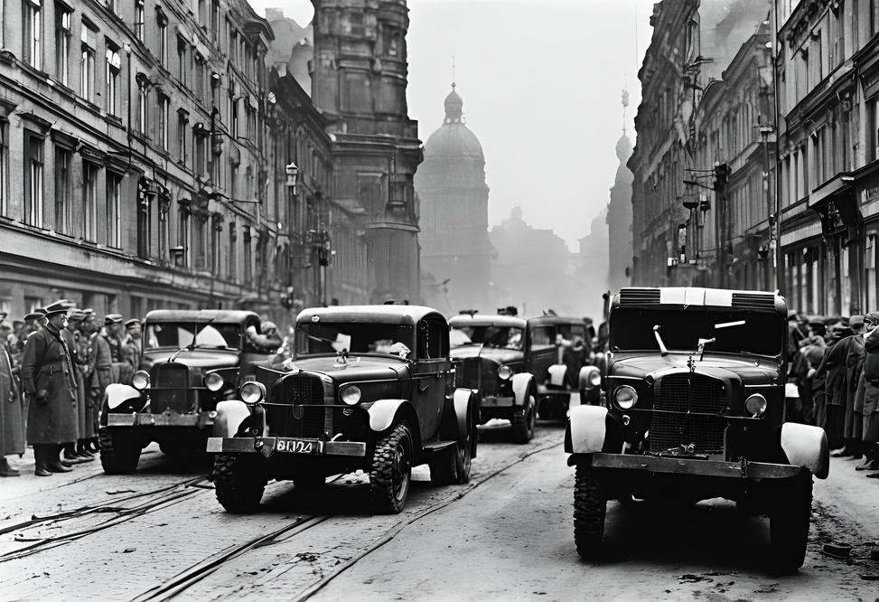
Defeat
and Damnation
As Allied forces advanced on Germany, Hitler's regime crumbled under the weight of defeat. On April 30, 1945, facing certain capture, Hitler committed suicide in his bunker in Berlin. The end of the war marked the defeat of Nazi Germany and the liberation of Europe from tyranny. Hitler's legacy remains one of infamy and horror, serving as a stark warning of the dangers of unchecked authoritarianism, extremism, and hatred.

Slide 13
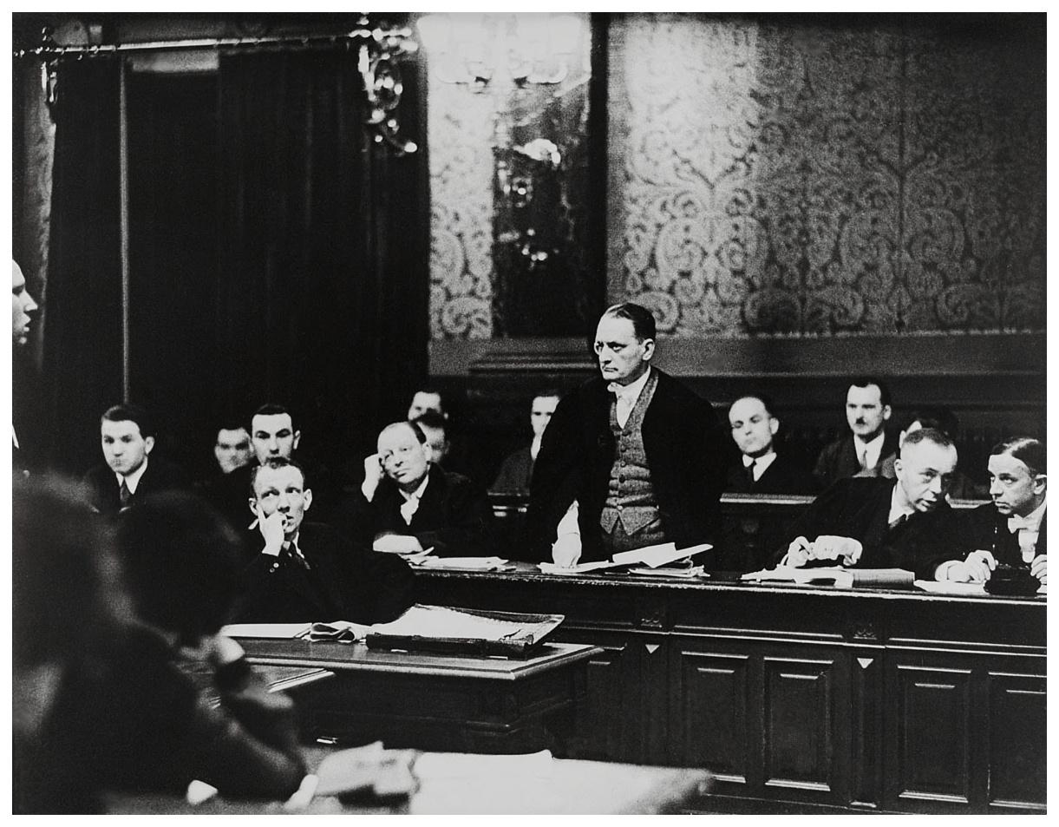
Nuremberg
Trials
In the aftermath of World War II, the Allies held the Nuremberg Trials to prosecute prominent leaders of Nazi Germany for war crimes, crimes against humanity, and other atrocities committed during the Holocaust. Several high-ranking Nazi officials, including Hermann Göring and Rudolf Hess, were convicted and sentenced for their roles in perpetrating the horrors of the Holocaust and waging aggressive war.

Slide 14
Honoring the Victims, Preserving Memory
Throughout the world, memorials, museums, and educational programs serve as reminders of the victims of the Holocaust and the atrocities committed under Hitler's regime. These efforts aim to preserve memory, educate future generations, and honor the millions of lives lost to hatred, bigotry, and intolerance.

Slide 15
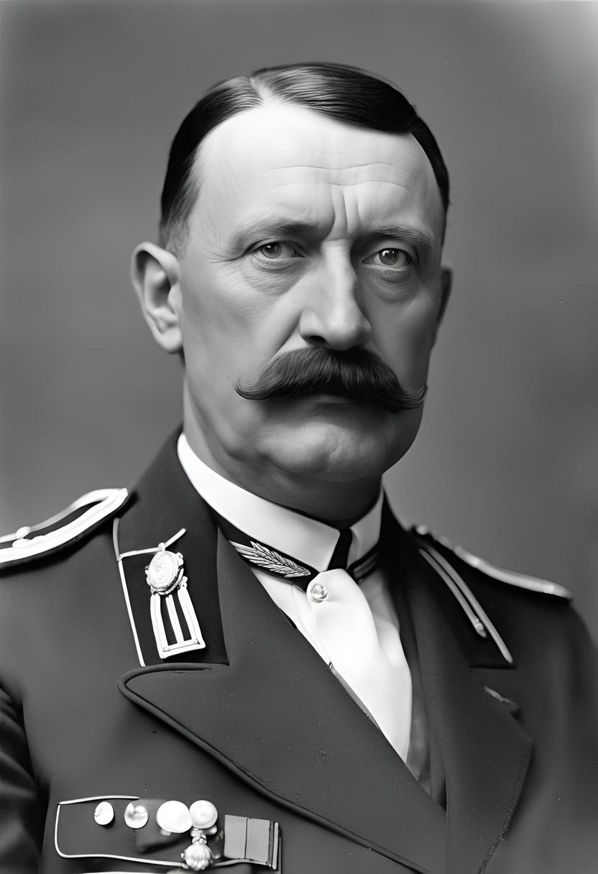
Remembering
the Past
As we conclude our journey through the life and legacy of Adolf Hitler, let us reflect on the profound impact of his reign of terror and the lessons learned from this dark chapter in history. May we remain vigilant against the forces of hatred and extremism, and strive to build a world guided by tolerance, compassion, and respect for all humanity.

Slide 16

Unveiling the Ideology of Adolf Hitler
Curious about the ideology that shaped history? Scan the QR code on your right to unlock the intricate beliefs of Adolf Hitler. Dive deeper into the complexities of his mind and the principles that drove his actions. Alternatively, visit [dummy link] to explore a detailed account of his thoughts and motivations. Discover the perspectives that influenced a tumultuous era and understand the historical context behind his rise to power.

Slide 17
That concludes our presentation.
Our stellar crew:
Sujith S : 22MIY0046
Our team leader, the mastermind behind the presentation and website, skillfully crafted the topic and brought it to life.
Tameem : 22MIY0004
One of our team’s key players, they’re the research wizard who dives deep into the content, shaping and sculpting what should shine in our presentation.
Ahmed S
Nivethan : 22MIY0018
A vital member of our team, they shine as the lead presenter and provide invaluable support to the research team.
Cilambarasan A : 22MIY0003
At the helm of the research team, they unearthed the history and curated the images that enriched our project.
Thank You

